Slide 1
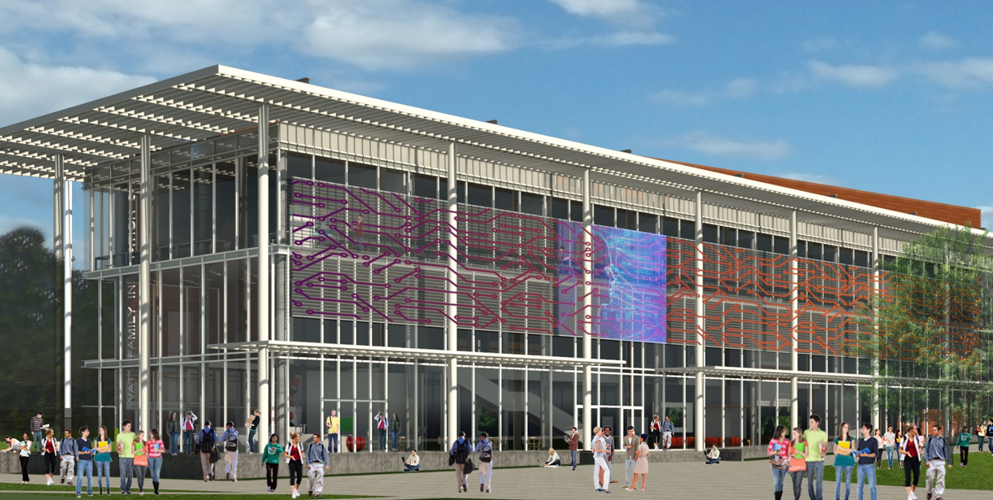

Purposeful & Enabling
THE WATT FAMILY INNOVATION CENTER
WFIC Overview

Slide 2
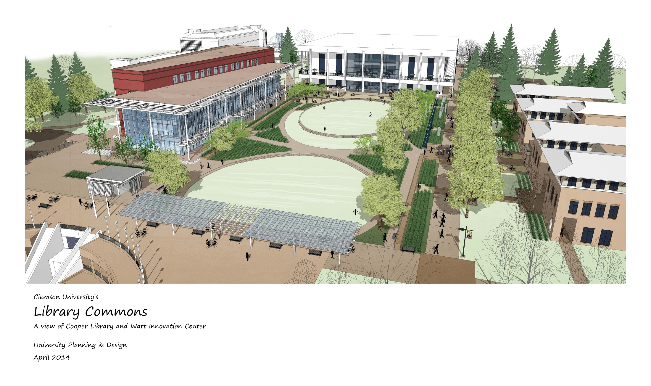
Day View
2

Slide 3
Vision
  A driving force for change that will enable Clemson University and its partners to lead in the development of creative solutions to significant technical and social challenges of the 21st Century by:
    Creating an intellectual center for collaboration and student engagement
    Establishing an interactive learning center for students, faculty, and partners
    Providing an agile interdisciplinary science and technology environment for education, discovery, and application of ideas
    Attracting and retaining the highest caliber faculty & students
    Enhancing the student academic learning experience through immersion in critical-thinking scenarios
    Involving industry, government, and academic partnerships to support programs of mutual interest

Slide 4

Fusion of Innovation Center Roadmap to Clemson’s 2020 Roadmap and 2020Forward
Top Students
Top Faculty
Creative Engagement
Competitive Infrastructure
People
Ideas
Technology
Reinforce Clemson’s recent designation as Top 20
National Public University by U.S. News & World Report

Slide 5
21ST Century Education
What are the critical skills our undergraduate students need?
Technical depth in a particular field
Creativity and innovation
Entrepreneurial outlook
Communication skills
Ability to work well as a member of a
diverse team
Global knowledge and experience
Commitment to lifelong learning
New facility must support

Slide 6
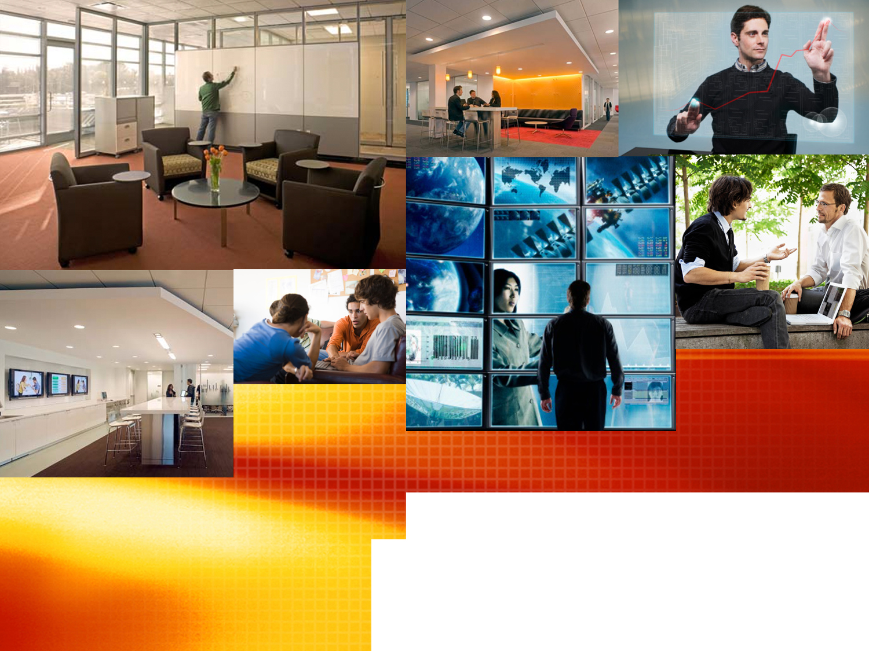

STUDENT-CENTERED ENVIRONMENT

Slide 7
Student-Centered Environment
TECHNOLOGY INFRASTRUCTURE
Clemson’s future is a complex map of interactive networks that constantly mutate and reshape the fabric of the institution
The new central campus innovation center must accommodate the dynamics through our campus Science & Technology infrastructure that encourages student-centered learning

Slide 8
Innovation Center Focus Areas
Academic quality and experimental learning activities require rigorous science and technology assessments, scholarly research, and conventional experiments to support transformation of faculty and student engagements
Advanced materials (nanomaterials and composites)
Big data science (HPC, social analytics, & bioinformatics)
Complex engineered systems (software defined networks)
Health innovation (technology, access, & delivery)
Human resilience (creative inquiry, entrepreneurship, leadership, & STEM)
Sustainable environment (energy management & recycling)
Cross-discipline academic curriculum and research

Slide 9
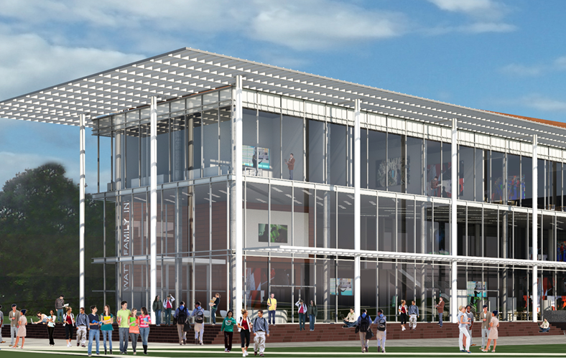
Basic Operational Concept Model
Wireless and Fiber Networks
Distributed
Systems
Global, National, State Connections
Central & External Campuses
Dynamic Programming,
Development & Asset
Control Center
Spaces Reconfigurable to Use Cases
Perkins+Will

Slide 10
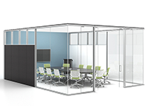
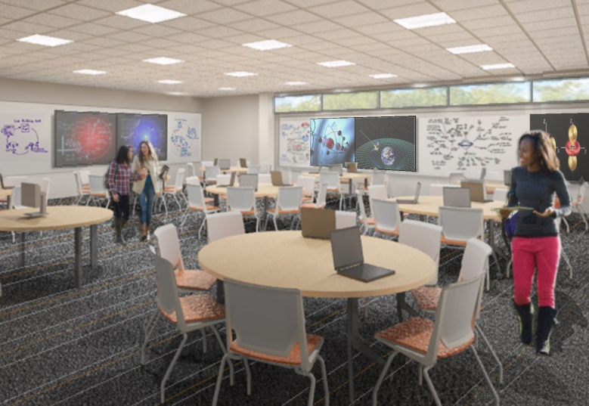
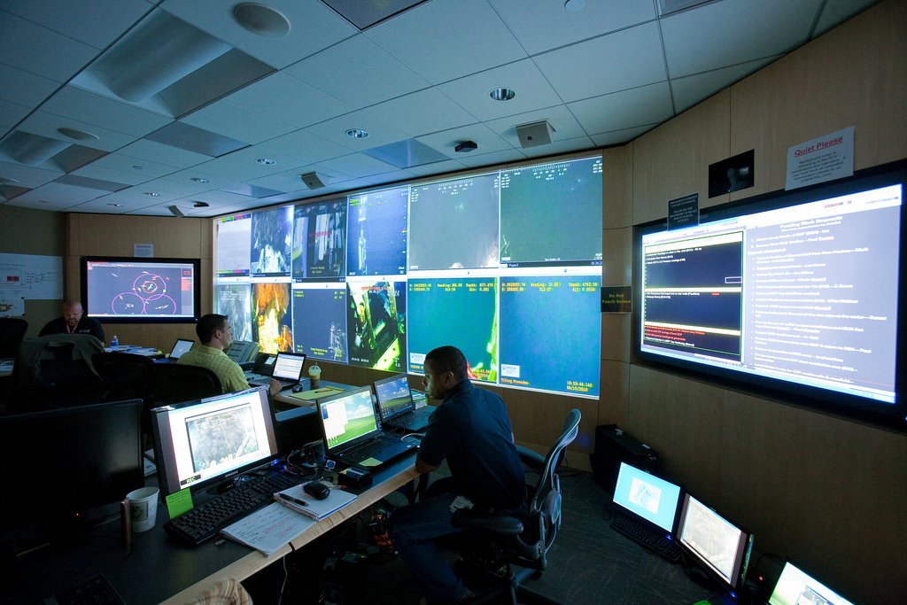


Audio Video Fact Sheet
73 WFIC spaces with AV
354 types of hardware
4372 pieces of hardware
65 different vendors
191 large-screen, high-res, touch monitors
12 video walls
  ranging from 8’x 5’ to 32’ x 9’
3D laser projection in auditorium
  13’ x 8’ screen
4 networks
  2 x 10G → 2+ x 100G
Videoconferencing
Lecture capture
Collaboration applications
Collaboration Spaces
Interactive Learning Spaces
Command Control Center
Ad Hoc Spaces
Media Lounges
Media Credits: Haworth & Perkins+Will

Slide 11

Innovation Center Academic Focus
Interactive learning
Student engagements
Technology demonstrations
Collaboration across disciplines
Partnerships and scholarly research
Creative Inquiry and special projects
Creativity and emerging technologies
Progressive use of autonomous processes
Virtual utilization of interactive infrastructure

Slide 12
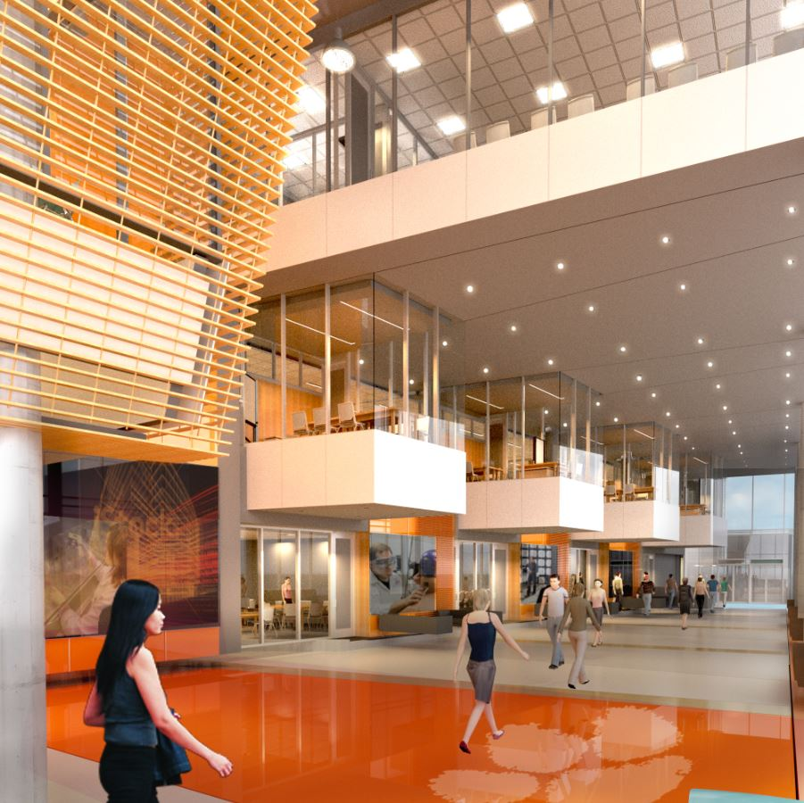
Innovation Center Enabling Facilities
Technology demonstration studios
Skills development studio
Immersive visualization areas
Project and collaboration areas
Scientific analytics and leadership studios
Scale-up cross-discipline interactive learning spaces
Science and technology scenario assessment area
Agile and reconfigurable fusion laboratories
Simulation and modeling support (3D) equipment areas

Slide 13
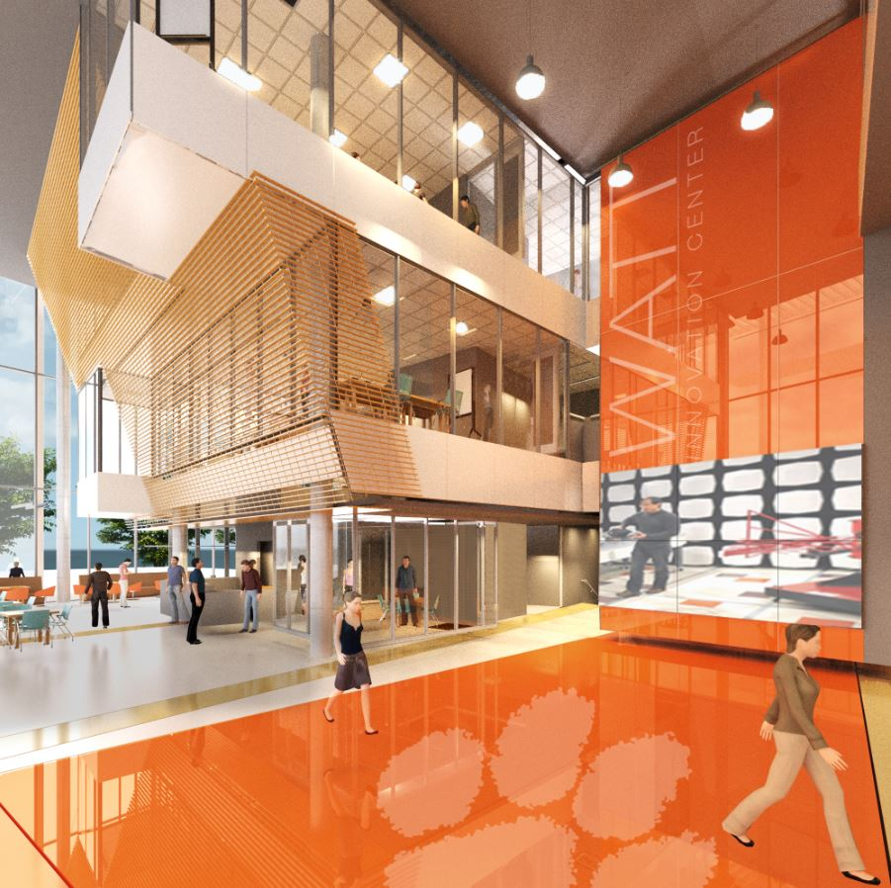
Innovation Center Enabling Facilities
Rapid prototyping area collaborations dedicated to partnerships
Meeting rooms (Small, Medium and Large)
Control center and academic resource center
Large auditorium and atrium for supporting academic research and partnership activities
Terrace rooftop to support scholarly and social interactions

Slide 14
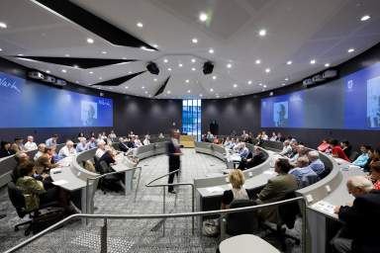
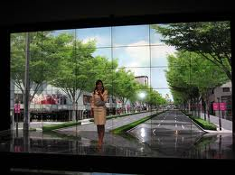
Innovation Center Basic Features
Visualization systems throughout the building including classrooms, laboratories and special project areas
Centralized control room for electronic delivery of interactive educational engagements
Deeply programmable software modules
Virtual connectivity to remote assets, extended operations and partnerships

Slide 15
WFIC Connectivity
WFIC
Innovation Partners
Networks
Satcom
Fiber optics
Wireless
Wideband
Secured
Enablers
HPC
Data
Mining
Analytics
Cross-domain
Collaboration Tools
Value Added
Board of Advisors
Assessments
Advertisement
Branding
Publications
Connectivity
Access to top students, faculty & researchers
Changing Markets
Financial Constraints
Global Distractors
Command &
Control
Virtual
Ops
New
Solutions
Virtual
Research
Academics
Social Trends
Visualization
S&T Drivers
21st Century Requirements
Clemson Extended Campuses, Partner Universities & NFP Institutes

Slide 16
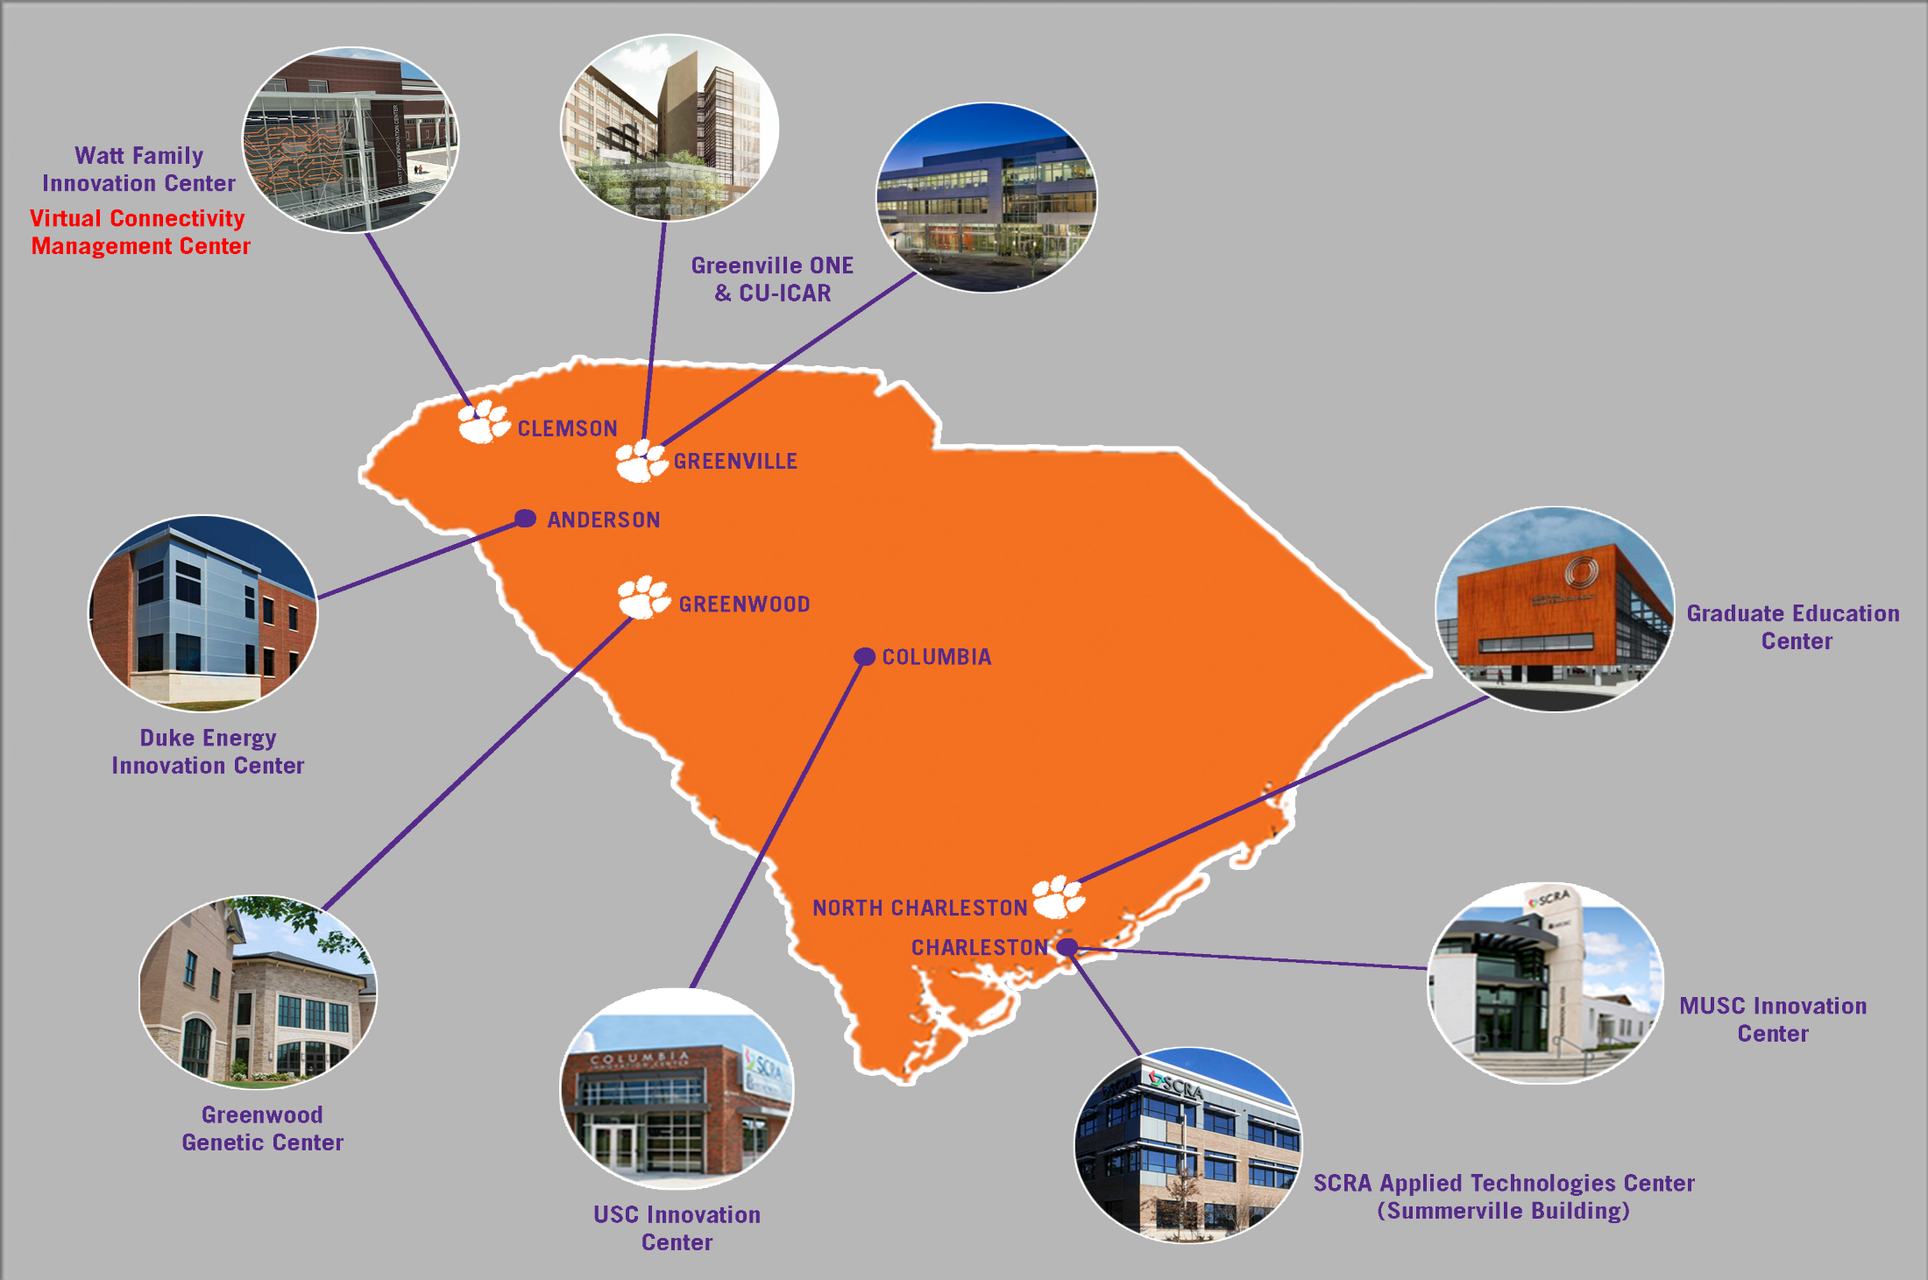


Virtual Connectivity
Collaborative Work Suites

Slide 17

an academic and research game changer
We will create an intellectual center
for collaboration and student engagement
17

Slide 18
WFIC & Creative Inquiry Programs Support 2020Forward Goals
High-impact engagement as a cornerstone of undergraduate education
Promotion of cross-disciplinary curricula that prepare students for the life and workplace environments
Growth in research and doctoral enrollment, especially in areas where we can achieve national prominence
Engage large numbers of undergraduate students, in all academic disciplines, in relevant, real-world research
Provide opportunities for undergraduate and graduate students to develop essential skills
Commitment to diversity and inclusiveness

Slide 19
Summary
The Innovation Center vision embodies the university strategy for 21st century education
Educational advancements are about providing the critical skills our students need to be successful in the workplace
Emphasis is on cross-disciplinary collaboration, innovation, & partnerships enabled by advanced technologies
An essential part of cost effective operations is virtual connectivity to critical assets and collaborative partners
Classes and research will start in the facility for the spring semester 2016

Slide 20
Timeline
September 2014
Structure Start
Site work complete
August 2015
AV Installation Starts
April 2014
Construction Start
December 2015
AV Training Complete
February 2015
Exterior Walls Complete
October 2014
Foundation Poured
March
2014
Groundbreaking
October 2015
Commission
Building
January 4, 2016
Building Ready for Classes that start on Jan 6
December 2014
Framework Complete
May 2015
Mechanical,
Electrical, Plumbing
Systems Complete
November 2015
AV Installation
Complete

